Slide 1
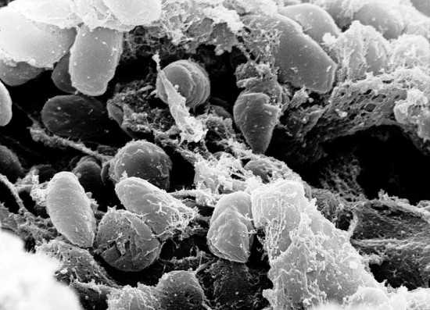
The Origin of Death
Dr. Rick Griffith • Jordan Evangelical Theological Seminary • BibleStudyDownloads.org

Slide 2
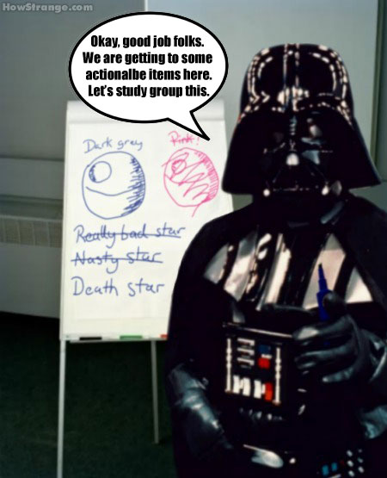
Death Star
OK, good job, folks. We are getting some actionable items here. Let’s study group this.
Notes:
Death is talked about in a flippant way today…

Slide 3
A New Hotel in Baku, Azerbaijan
The Death Star Hotel
Notes:
~Queue the evil music~ Now that's weird. Beautiful, but weird. Here are the proposed specs: 521-feet-high, 104,182 square meters, 382 rooms and over 35 floors. I'm sure the new construction will offer first-class amenities! Who's on board for a trip to Baku?! From http://www.4hotels.us/death-star-hotel/

Slide 4
Physical Death
48
For Your Small Group:
Most people don't like to think or talk about death. Why not?

Slide 5
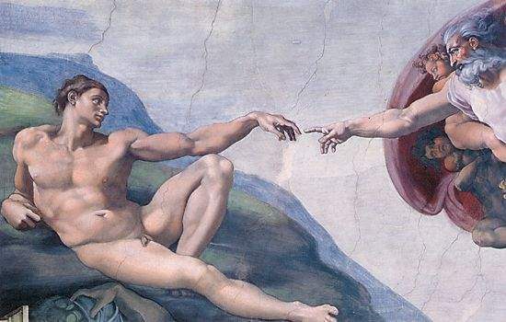
Man
God's Creation…Day 6
448
"Then God said, 'Let Us make man in Our image, according to Our likeness; and let them rule over the fish of the sea and over the birds of the sky and over the cattle and over all the earth, and over every creeping thing that creeps on the earth'" (Gen. 1:26).

Slide 6
Woman
God's Creation…Day 6
"So God created man in his own image
in the image of God he created him
male and female he created them" (Gen. 1:27).

Slide 7
Mandate
448
and over the birds of the air
"And God blessed them, and God said to them, 'Be fruitful and multiply, and fill the earth and subdue it;
and have dominion over the fish of the sea
and over every living thing that moves upon the earth'" (Gen. 1:28 NLT).

Slide 8
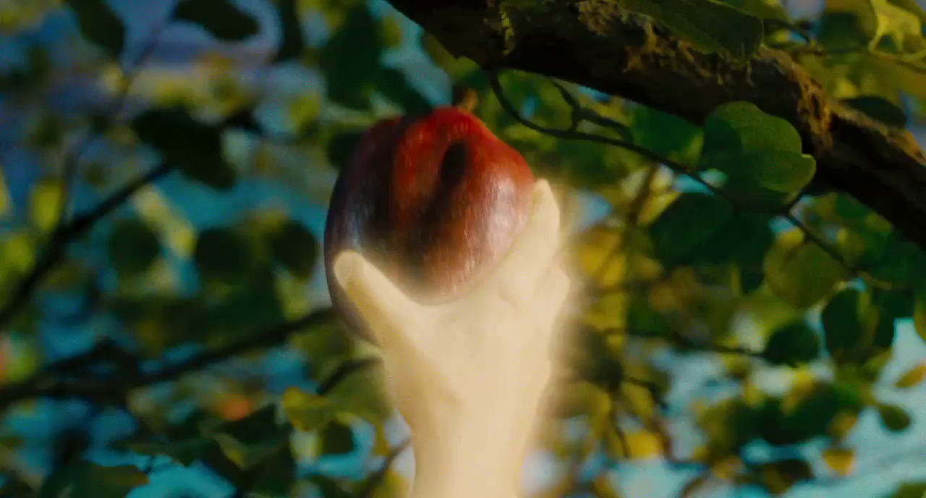
"The LORD God commanded the man, saying, 'From any tree of the garden you may eat freely; ¹⁷but from the tree of the knowledge of good and evil you shall not eat, for in the day that you eat from it you will surely die'" (Gen. 2:16-17 NAU).

Slide 9
"But the LORD God warned him, 'You may freely eat the fruit of every tree in the garden ¹⁷—except the tree of the knowledge of good and evil. If you eat its fruit, you are sure to die'" (Gen. 2:16-17 NLT).

Slide 10
Convincing Dialogue
You will NOT surely die. When you eat of the fruit, your eyes will be open and you will be like GOD, knowing good and evil.

Slide 11
Convincing Dialogue
Your transparent appeal to our pride and naïveté is no match for the security and joy we have here in God’s presence.

Slide 12
Convincing Dialogue
It’s organic, rich in antioxidants, and now available in convenient GO-PACKS.
We’ll take two.

Slide 13
"The woman was convinced. She saw that the tree was beautiful and its fruit looked delicious, and she wanted the wisdom it would give her. So she took some of the fruit and ate it. Then she gave some to her husband, who was with her, and he ate it, too'" (3:6 NLT).
Notes:
Eve's bodily cravings, greed and pride motivated her and Adam to sin by eating the fruit (3:6).

Slide 14
The Blame Game
Notes:
What, then, were the results of this first sin of man? One might call it "The Blame Game"!

Slide 15
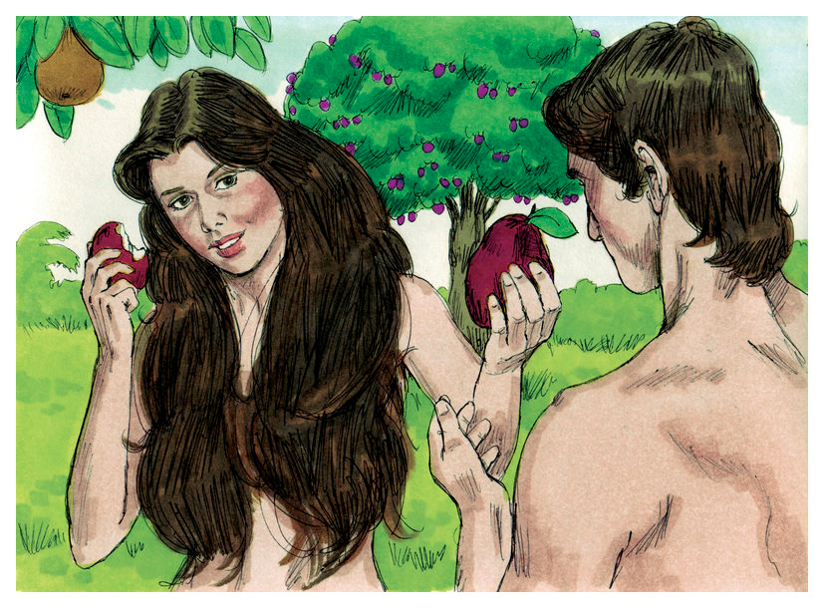
The Blame Game
Notes:
God asked Adam what he had done.
Adam blamed Eve (and God): "The woman YOU gave me…" (3:12)
God then asked Eve what she had done.
Eve blamed Satan: "The serpent deceived me…" (3:13)
The only one who didn’t blame someone else was the serpent!

Slide 16
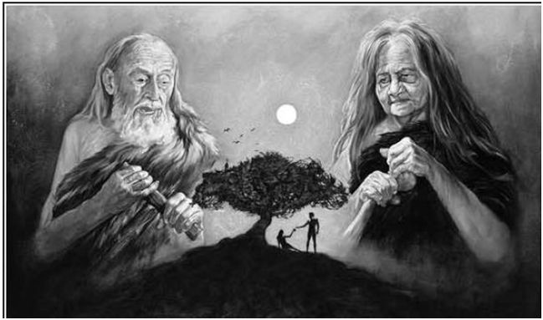
Adam died
Adam did not die for another 930 years (Gen. 5:5), but he did die
Notes:
Adam's physical death did not come for another 930 years (Gen. 5:5), but his spiritual separation (death) came immediately upon sinning against God.

Slide 17
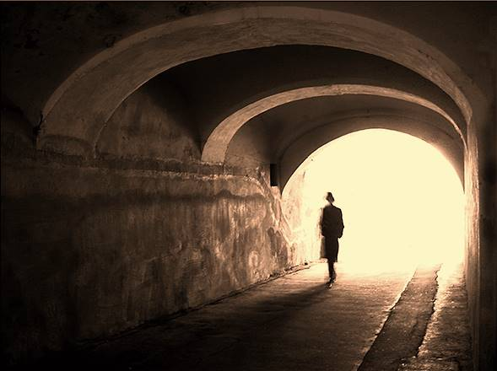
Death is Real
48
Everyone dies eventually (by old age, accident, war, murder, natural disaster, famine, etc.)
No one can avoid one's own death
“…man is destined to die once, and after that to face judgment” (Hebrews 9:27)

Slide 18
Types of Death
48
Three Types of Death:
Spiritual Death: Separation of the person from God (Eph. 2:1-2)
Physical Death: Separation of the soul from the body (Gen. 35:18-19; Eccl. 12:7; James 2:26)
Second Death (Eternal Death) Separation from the presence of God in an endless period of punishment (Rev. 20:14; 21:8)
Gen. 35:18-19 (NAU) “It came about as [Rachel’s] soul was departing (for she died), that she named him Ben-oni [“son of my sorrow”]; but his father called him Benjamin [“son of my right hand”]. ¹⁹So Rachel died and was buried on the way to^{b}Ephrath (that is, Bethlehem).”
Eccl. 12:7 (NIV) “and the dust returns to the ground it came from, and the spirit returns to God who gave it.”
James 2:26 (NIV) “As the body without the spirit is dead, so faith without deeds is dead.”

Slide 19
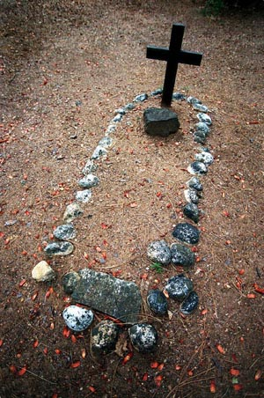
"By the sweat of your brow will you have food to eat until you return to the ground from which you were made. For you were made from dust, and to dust you will return" (3:19 NLT).
Adam & Eve began to die spiritually
Notes:
Adam’s physical death did not come for another 930 years (Gen. 5:5), but his spiritual separation (death) came immediately upon sinning against God.

Slide 20
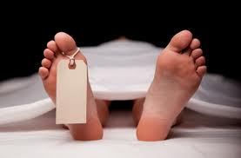
Physical Death
Natural or Unnatural?
“Though death is both real and inevitable, it is unnatural. When God created the heavens and the earth, death was not part of it. And that is why, eventually, death will be finally conquered (1 Cor. 15:26).”
Paul Benware, Understanding End Times Prophecy, 346

Slide 21
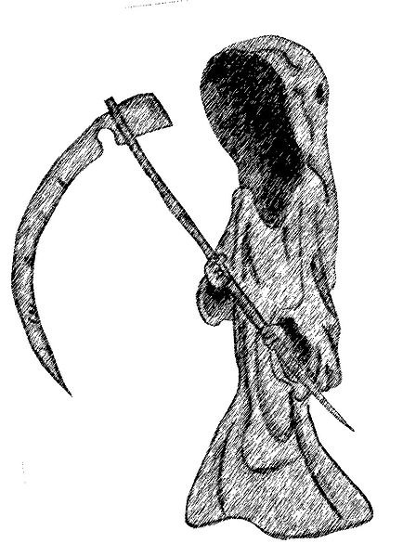
Physical Death
Natural or Unnatural?
“Physical death was not an original part of the human condition. It is something foreign and hostile. Paul pictures it as an enemy
(1 Cor. 15:26).”
Erickson, Christian Theology, 1177

Slide 22
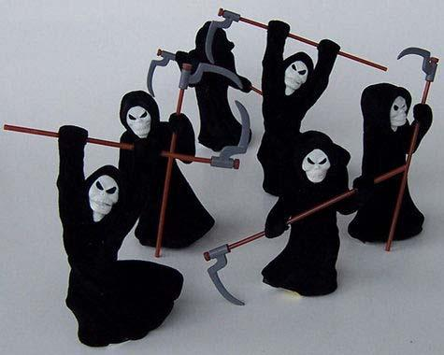
Physical Death
Natural or Unnatural?
“We must still remember that death is not natural, it is not right; and in a world created by God it is something that ought not to be. It is an enemy, something that Christ will finally destroy (1 Cor. 15:26)”
Grudem, Systematic Theology, 812

Slide 23
Summary of Types of Death
48
 | Spiritual | Physical | Second
Definition: Separation | of man & God | of body & soul/spirit | of man & God
Experienced by | unbelievers only | all mankind | unbelievers only
Location of soul | earth | Hades or Paradise/Heaven | Hell (Lake of Fire)
Part of man affected | soul | body | soul and body
Time period involved | before conversion | between life & resurrection | after resurrection
Duration | temporal | temporal | eternal
Key passage | Eph. 2:1, 5, 12 | James 2:26 | Rev. 20:14-15

Slide 24
Death
Death is not natural because it is the penalty for sin and needs to be destroyed.
“For the wages of sin is death, but the gift of God is eternal life in Christ Jesus our Lord”
(Rom. 6:23)
“The last enemy to be destroyed is death”
(1 Cor. 15:26)

Slide 25
Reponses to Death
49
Death to the Unsaved = Fear:
Death is a curse, penalty, & enemy.
They will experience physical, spiritual, and eternal death for not believing in Christ as their Savior.
Therefore, the penalty for sin is upon them in these three areas of death (Rom. 6:23).

Slide 26
Reponses to Death
49
Death of the Believer
The believer still dies physically, but its curse is gone because Christ himself become a curse for us by dying on the cross (Gal. 3:13).
While believers still die physically, they do not experience spiritual and eternal death.

Slide 27
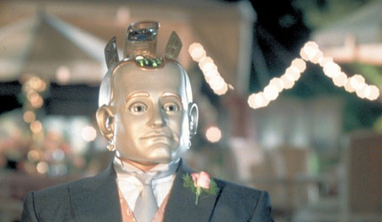
Bicentennial Man (1998)
Notes:
This movie exalts death. The robot who "lives" 200 years is finally granted the "privilege" to legally die in the end, which is deemed to make him human. What a twisted theology!

Slide 28
Reponses to Death
49
How should we think of our own death?
We do not fear our own death because when we die, our spirit will be with the Lord (2 Cor. 5:8).
Scripture also assures us that death cannot separate us from the love of God in Jesus Christ (Rom. 8:38-39).

Slide 29
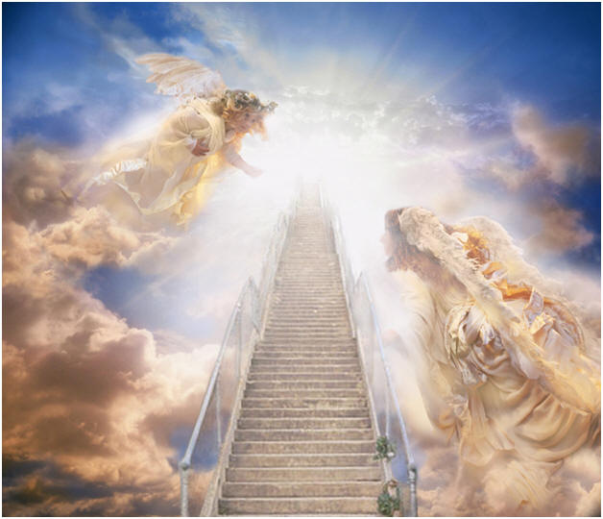
Reponses to Death
49
How should we think of the death of Christian friends and relatives?
We may mourn for them in sorrow.
However, at the same time we have hope and joy because they will be with the Lord (2 Cor. 5:8) and they will live with the Lord (1 Thess. 5:10).

Slide 30
Reponses to Death
How should we think of the death of unbelievers?
Our sorrow will be very deep because they will go through spiritual and eternal death forever.

Slide 31
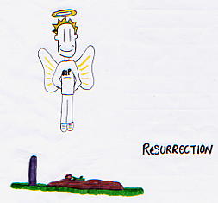
Summary
For Believers…
Our penalty for sin was paid by Jesus Christ.
We should not fear death though we will die someday.
We will be with our Lord Jesus when we die.
Death is but an entrance into a better mode of life.
Resurrection
Death is…
unnatural
not God's intention
penalty for sin
not extinction

Slide 32
Future of Physical Death
49
Second Coming
Great White Throne Judgment
Church Age
Tribulation
Millennium
Eternal Kingdom
7 years
1000 years
Increased
Judgment
Universal
Decreased
Death:
Eliminated
Notes:
32

Slide 33
The Source of Death
49
When did death begin?

Slide 34
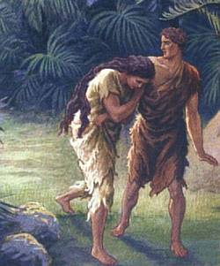
Did death exist before sin?
What do you think?
VERY GOOD
What does it mean that creation was "very good" if death existed then?
Notes:
So did death exist before sin? What do you think? God said that his creation up to this time was "very good." What does it mean that creation was "very good" if death existed then?

Slide 35
Is death natural?
Depends on who you ask…

Slide 36
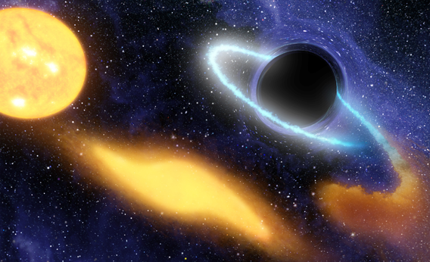
“Black Hole Grabs Starry Snack”

Slide 37
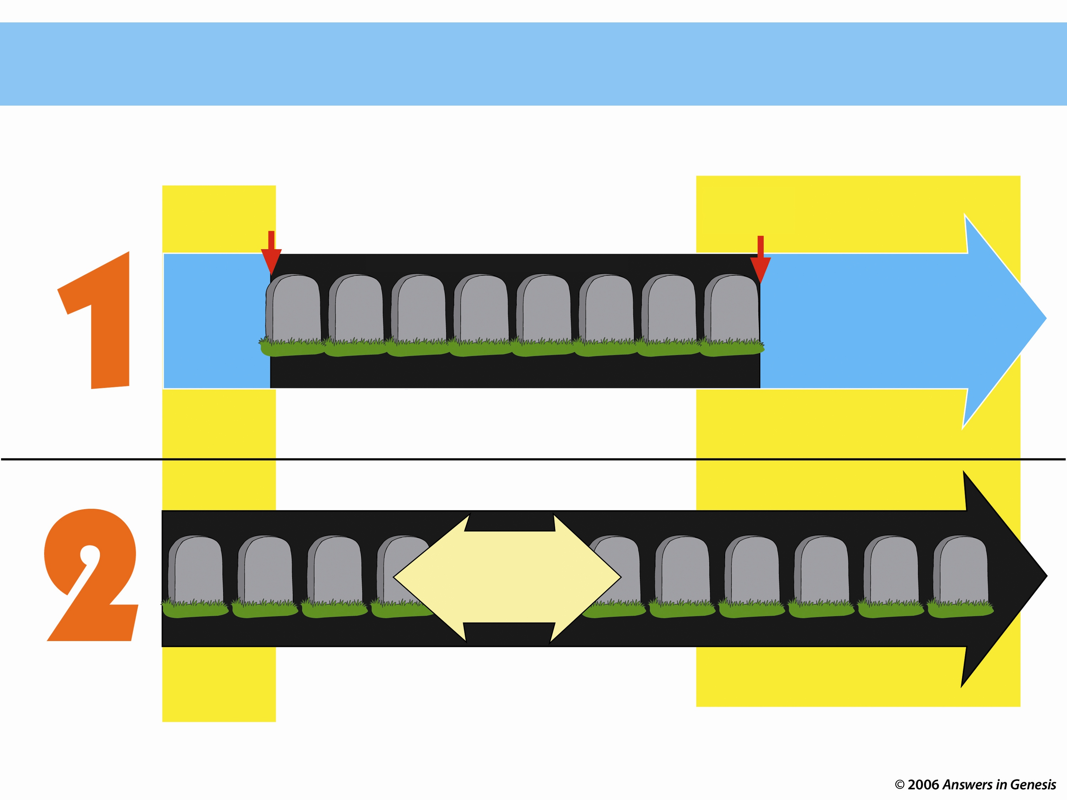
Two Histories of Death
49
Beginning
Death is an enemy
Future
Man's sin brought Death
DEATH will be done away with
ONLY THOUSANDS OF YEARS
God's Word
NO DEATH
NO DEATH
Death is temporary
Man's Opinion
MILLIONS AND MILLIONS OF YEARS
Move the black box over to translate underneath
Life and death have always been together
Death is a permanent part of history
As long as there is life, there will be death
Notes:
Genesis 1–3 teaches that there was no death initially, but man’s sin brought death into the world—yet we look to a future without death.
However, man’s opinion is that life and death have always been together for millions of years and as long as there is life, there will be death! How sad!

Slide 38
Fossils on Garden of Eden
GARDEN OF EDEN
PAIN
FOSSIL RECORD
DEATH
Noah's
Flood
KILLING
DISEASE
STRUGGLE
SUFFERING
EXTINCTION
Notes:
The Bible says that it all started good, but the fossil record shows horrible things that came out of the Flood.

Slide 39
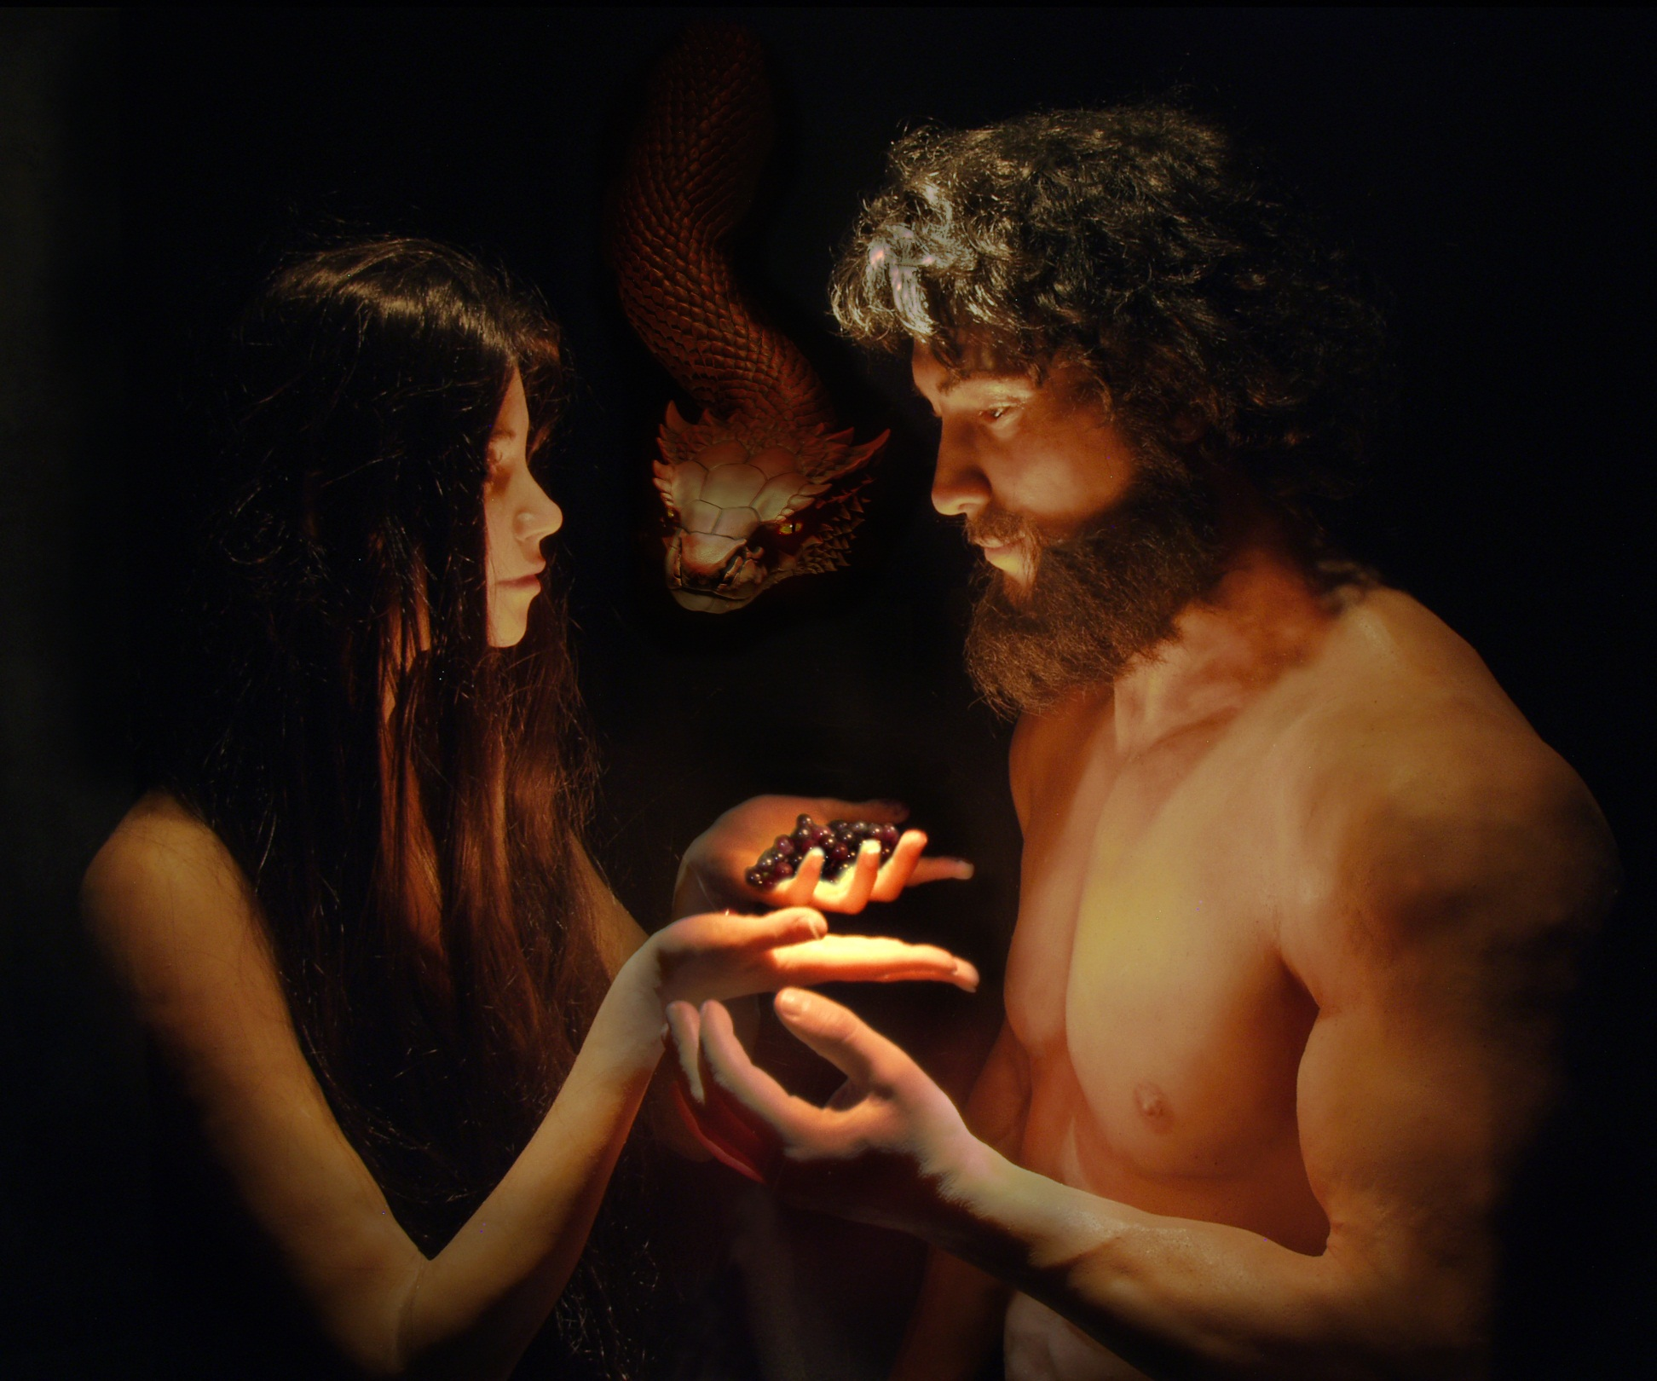
Romans 5:12 (NAU)
"Therefore, just as through one man sin entered into the world, and death through sin, and so death spread to all men, because all sinned"
Notes:
It all started with Adam.

Slide 40
Romans 5:12 (NLT)
"When Adam sinned, sin entered the world. Adam's sin brought death, so death spread to everyone, for everyone sinned"
Notes:
The NLT renders this…

Slide 41
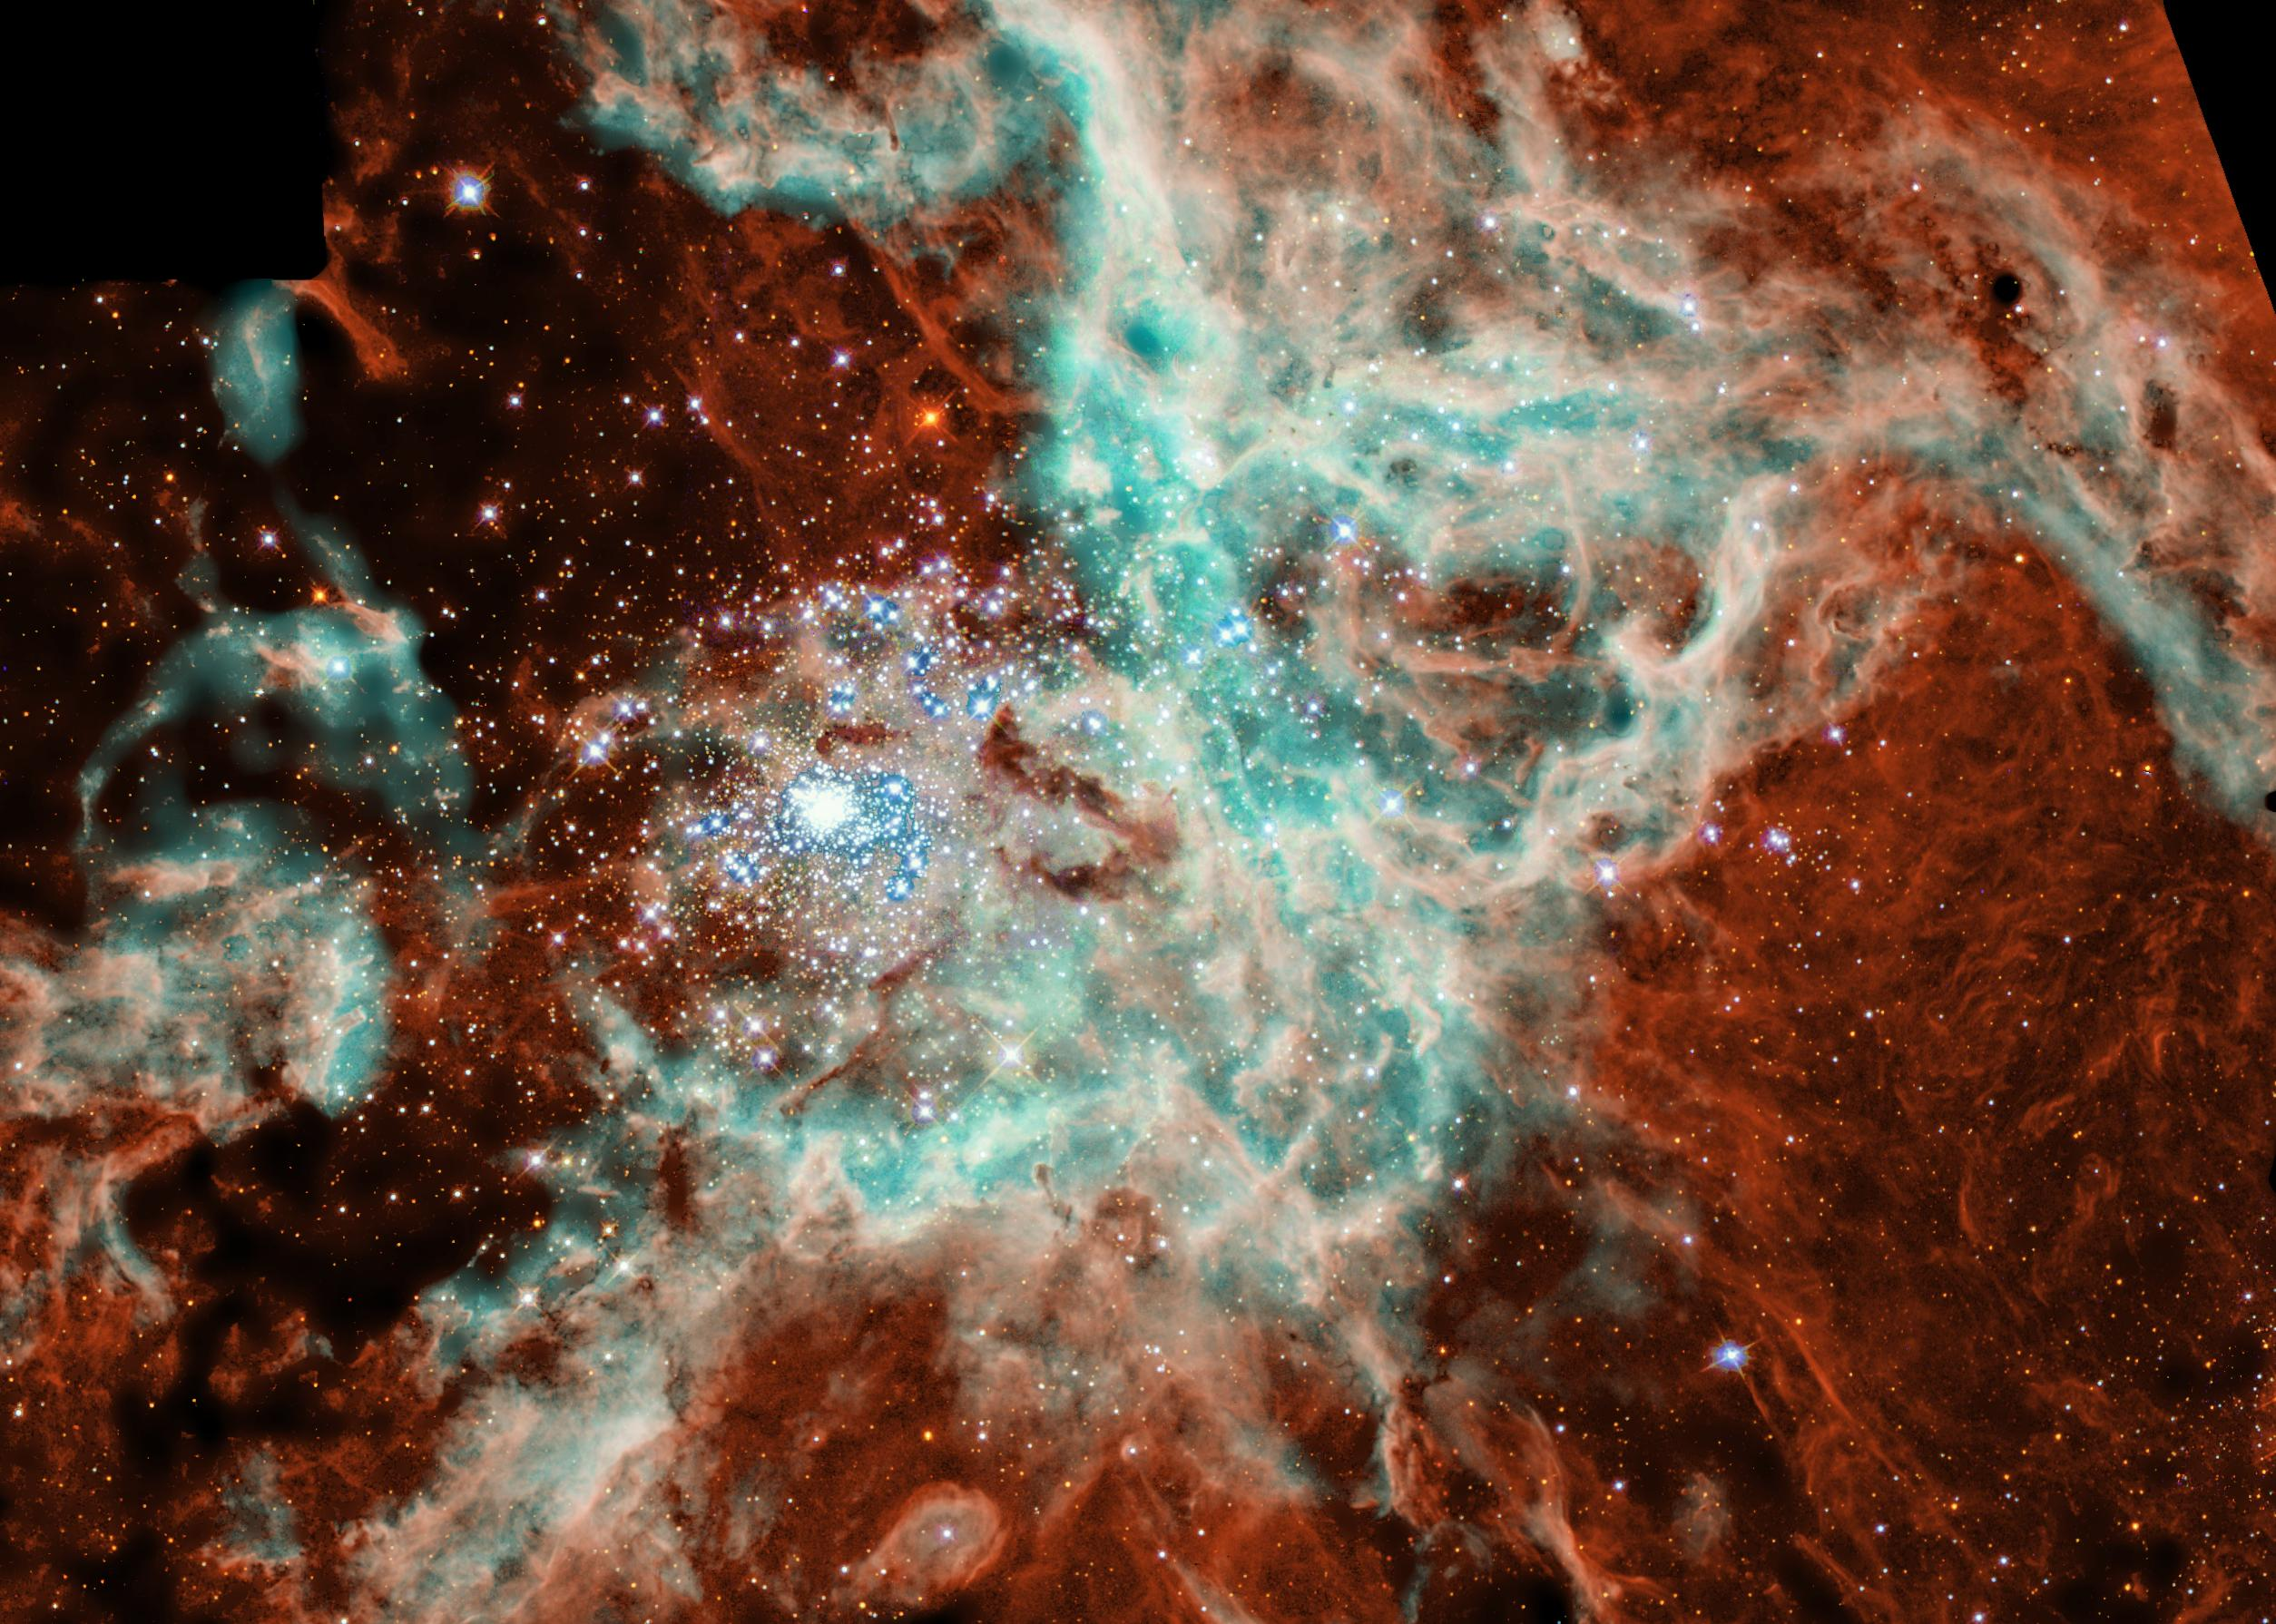
Is Genesis 1–11 Real History?
Theological Problems
OTS 58
3.a.
Myths don't teach “deep truths” better than history
A non-historical approach is very subjective
They have vital information otherwise not known
They fit into the book's argument emphasizing election
Events are presented as historical
Science confirms the Genesis 1–11 historical record
Christ affirmed their historicity (Matt. 19:4-6)

Slide 42
The Fall and the Origin of Moral Evil
Theological Problems
32
3.b.
The story of Adam and Eve is “a poetic and powerful allegory of God's plan for the entrance of the spiritual nature (the soul) and the Moral Law into humanity” (Francis Collins, 207).
Notes:
Francis Collins, The Language of God, 207

Slide 43
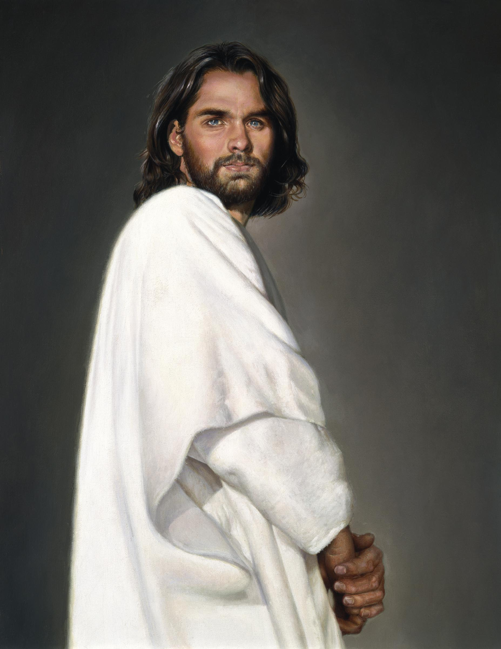
Adam versus Christ
32
3.b.
Romans 5:12-14
1 Cor. 15:22
1 Cor. 15:45-49

Slide 44
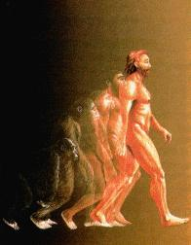
The Origin of Man
Theological Problems
32
3.c.
Created from dust (Gen. 2:7; Matt. 19:4)
Image of God (Gen. 1:26-27)–not of apes
Eve was “mother of all living” (Gen. 3:20; Acts 7:26)
All sinned in Adam (Rom 5:12)
or…

Slide 45
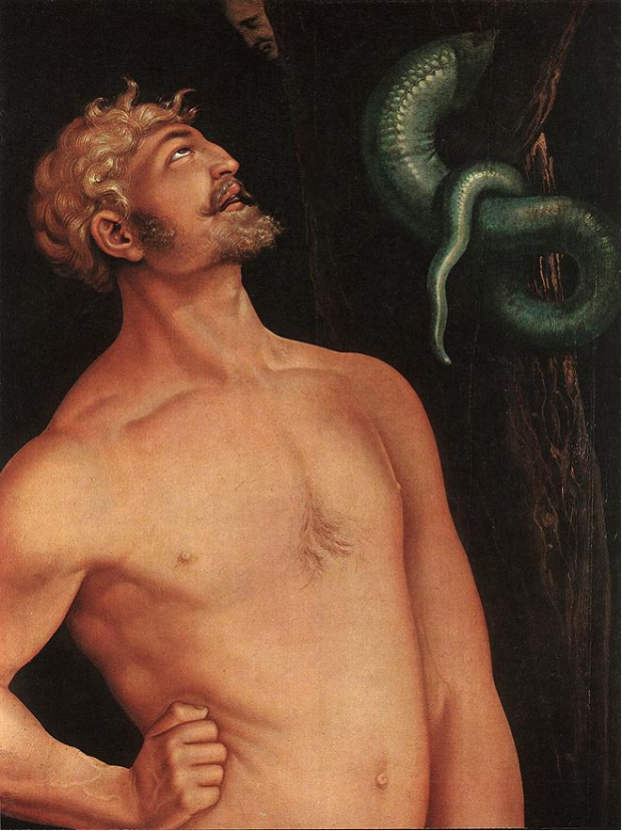
Natural Selection, Death, & Suffering
Theological Problems
33
3.d.
Creation Going into Genesis 3:
Monotheism
Sovereign God
All is “Good”
Man without sin
No pain or evil
Ruling with God
Notes:
Baldung Grien, Hans: Adam 1520-23; Wood, 208 x 83.5 cm; Museum of Fine Arts, Buda
www.ibiblio.org/wm/ paint/auth/baldung/adam-eve/

Slide 46
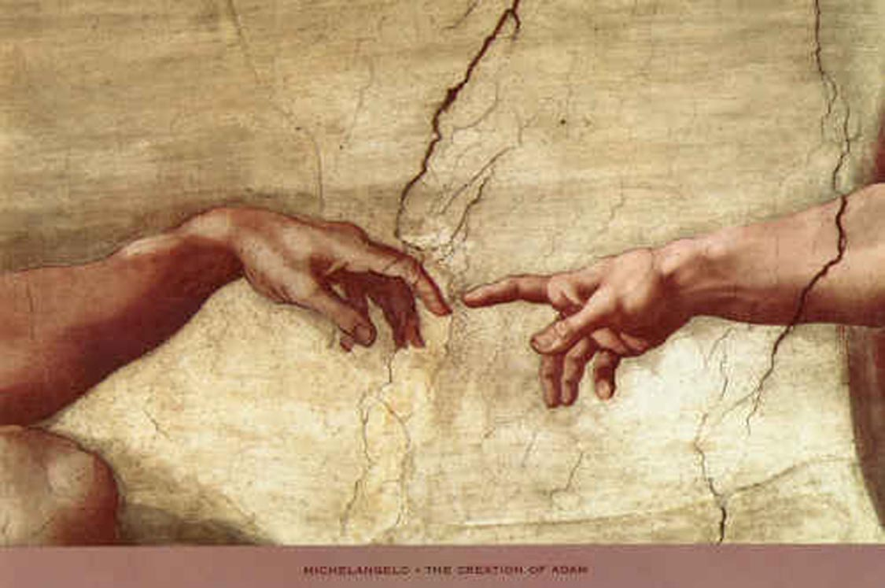
Who is Man–Really?
Theological Problems
33
3.e.
Created from the dust (Gen. 2:7)–not from lower life forms
Highest of created beings (Gen. 1:26-27)–made in God's image
Commissioned to rule with God (Gen. 1:28)–neither an animal nor a god

Slide 47
Man, like the animals, reproduces after his own kind
Theological Problems
33
3.e.

Slide 48
Distinctions Between Man & Animals
Theological Problems
33
35
3.e.
Ability to discern truth (2:16-17)
Ability to speak (2:23)
Marriage & relationships (2:24)
Creative abilities (2:19-20)

Slide 49
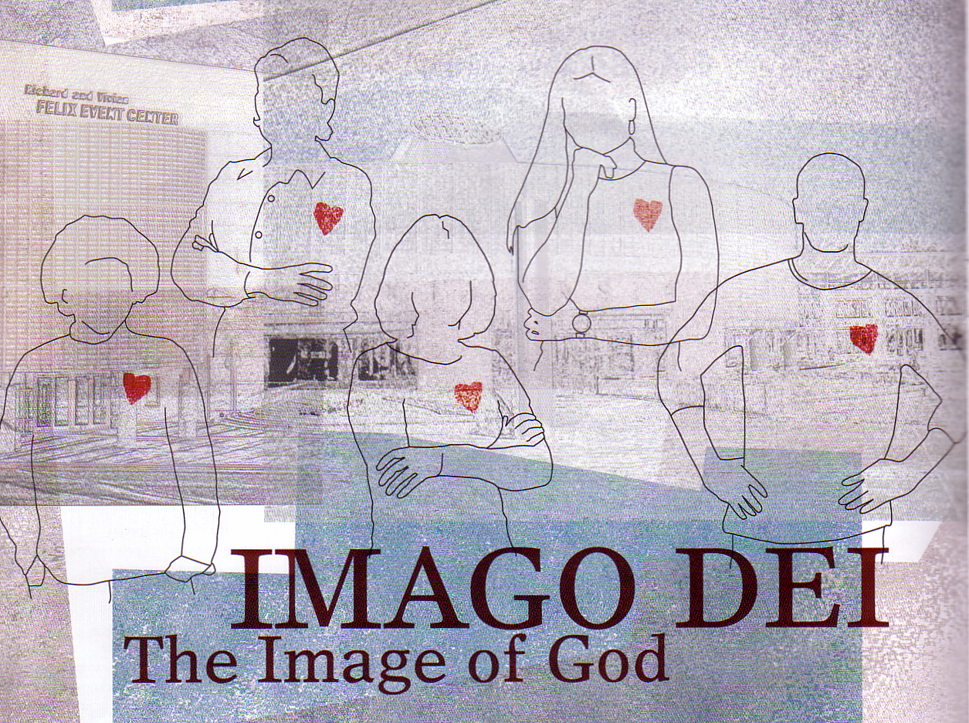
What is this image?
Theological Problems
33
35
3.e.
Right to rule creation (1:26)
Ability to relate to God (2:16ff.)
Dignity of humankind (9:6)

Slide 50
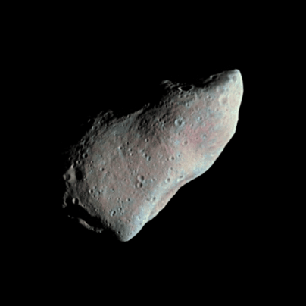
Is there evidence of intelligent design?
Francis Collins argues against intelligent design (pp. 85-88)

Slide 51
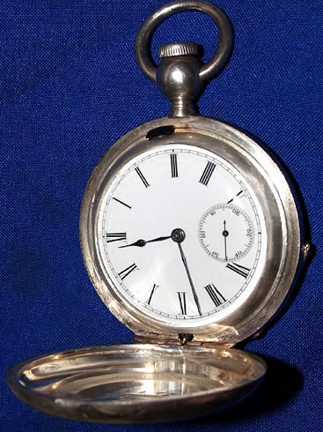
The Watch Illustration (William Paley, 1802)
A watch is complex.
A watch has an intelligent designer.
Life is complex.
Therefore, life also has an intelligent designer.

Slide 52
The Critique by Francis Collins
“The fact that two objects share one characteristic (complexity) does not imply that they will share all characteristics” (p. 87)
Electric current in my house consists of a flow of electrons.
Electric current comes from the power company.
Lightning consists of a flow of electrons.
Therefore, lightning comes from the power company.
A watch is complex.
A watch has an intelligent designer.
Life is complex.
Therefore, life also has an intelligent designer.
Do you agree?

Slide 53
A Better Parallel
Electric current in my house consists of a flow of electrons.
Electric current comes from a power source.
Lightning consists of a flow of electrons.
Therefore, lightning comes a power source.
A watch is complex.
A watch has an intelligent designer.
Life is complex.
Therefore, life also has an intelligent designer.

Slide 54
Evangelicals Differ
34
OTS 34
Reasons to Believe
Hugh Ross
Walt Brown
Old Earth
Progressive Creation
Mid-East Flood
Rain waters
reasons.org
godandscience.org
creationscience.com
Creation Research Institute
Henry/John Morris, Duane Gish
Joseph Dillow, Ken Ham
Young Earth
24-hour Creation Days
Universal Flood
Vapor canopy
answersingenesis.org
genesispark.org
icr.org critiques Ross at:
icr.org/pubs/imp/imp-217.htm

Slide 55
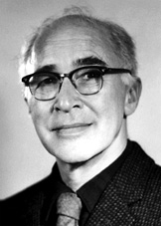
Edwin Did life originate as an accident?
“There are only two possible explanations as to how life arose: Spontaneous generation arising to evolution or a supernatural creative act of God…. There is no other possibility. Spontaneous generation was scientifically disproved 120 years ago by Louis Pasteur and others, but that just leaves us with only one other possibility… that life came as an act of supernatural creation by God, but I can't accept that philosophy because I do not want to believe in God. Therefore, I choose to believe that which I know is scientifically impossible, spontaneous generation leading to evolution.”
Dr. George Wald
Professor Emeritus of Biology, Harvard
Nobel Prize winner in Biology, 1971
Notes:
George Wald, “Origin, Lie and Evolution,” Scientific American 1978); cited by Joe White and Nicholas Comninellis, Darwin's Demise (Green Forest, AR: Master Books, 2001), 46.

Slide 56
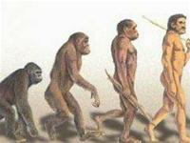
Make Your Choice: How did order come?
By unintelligent random processes?
Or by design from an intelligent God?

Slide 57
AiG Web Address 00439

Slide 58
Black

Slide 59
Creation link at BibleStudyDownloads.org
Get this presentation for free!
Notes:
OT Survey (os)

